Slide 1

Project WhatsOp
IOS XE Messaging Platform
Gabriel Zapodeanu
Technical Marketing Engineer, Cisco Systems
@zapodeanu, github.com/zapodeanu

Slide 2

Gabriel Zapodeanu
Technical Marketing Engineer, ENB, Cisco Systems
Gabriel Zapodeanu is a Network Programmability Technical Marketing Engineer.
He recently joined the Cisco Enterprise Networking Business, focused on controllers programmability – Cisco DNA Center, SD-WAN and ISE.
Prior to his current role he was a Programmability Technology Architect, part of the Global Partner Organization, focused on partner technical enablement programs, APIs use case development across various technologies, as well as learning and certifications programs.
After joining Cisco in 2006 he was an Systems Engineer in the West Area Enterprise Organization, Oregon USA. His work included large architectures for a variety of Enterprise customers from manufacturing, utilities, retail, transportation, healthcare, education, and financial industries.
Gabriel completed his Cisco Business Architecture Certification #373 ,and recently, co-authored the book "IOS XE Programmability: Automating Device Lifecycle Management”.

Slide 3
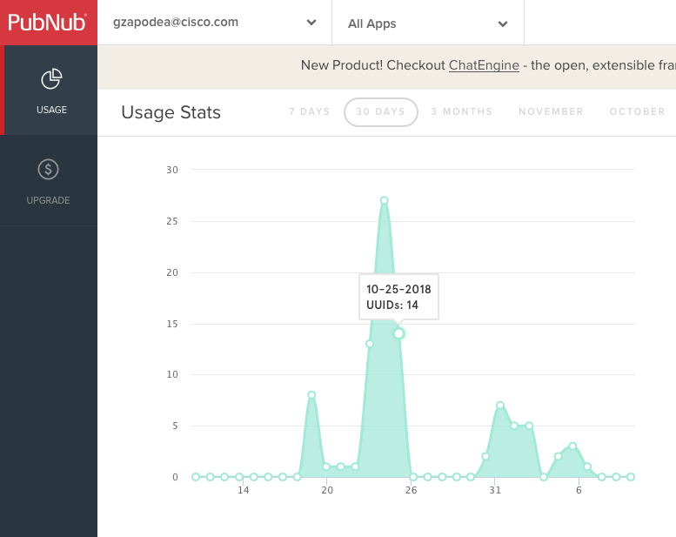
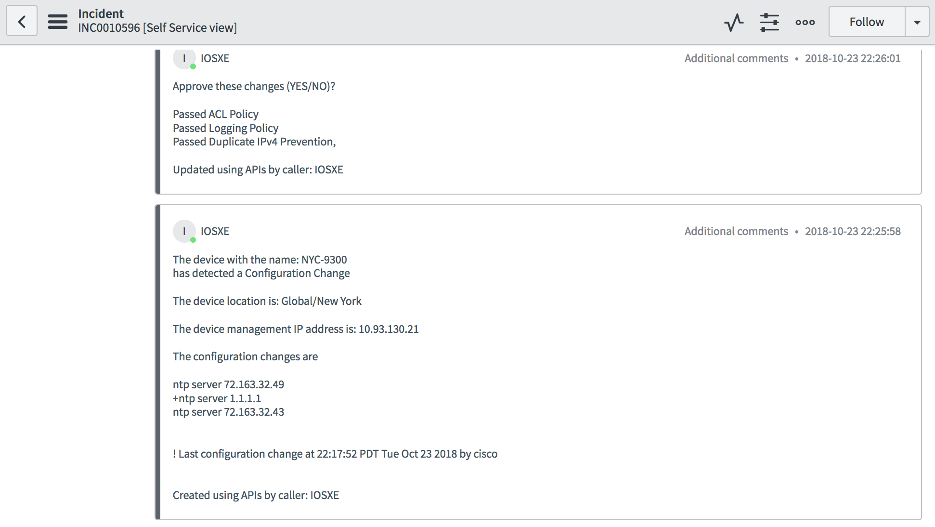
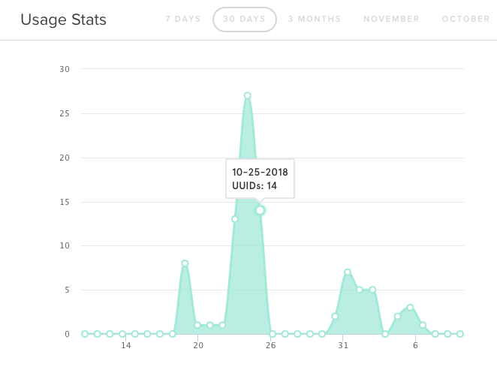
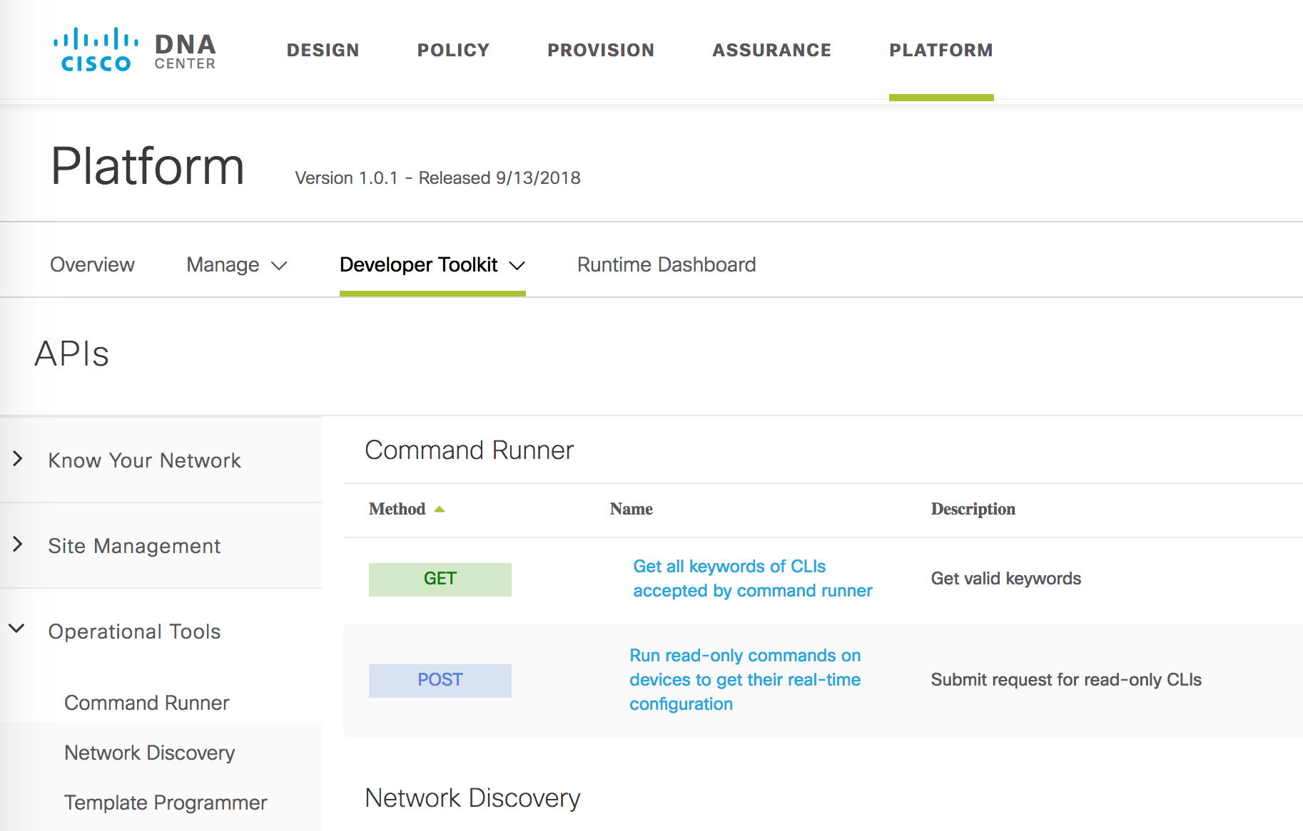
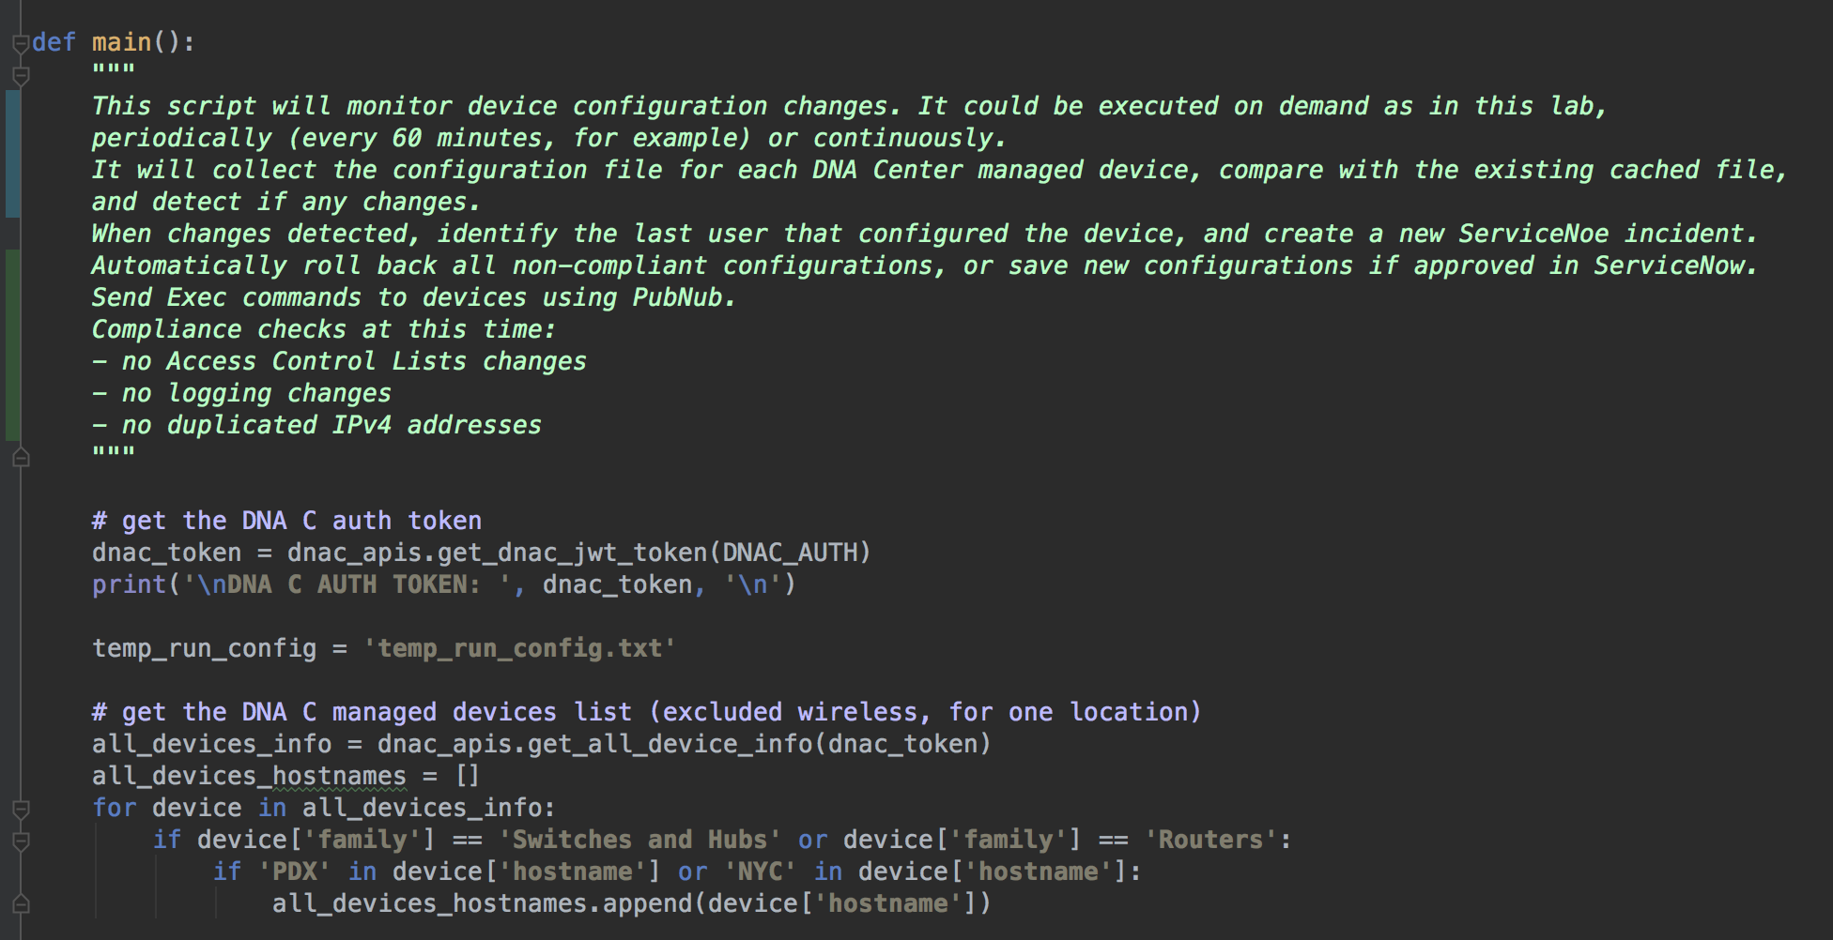
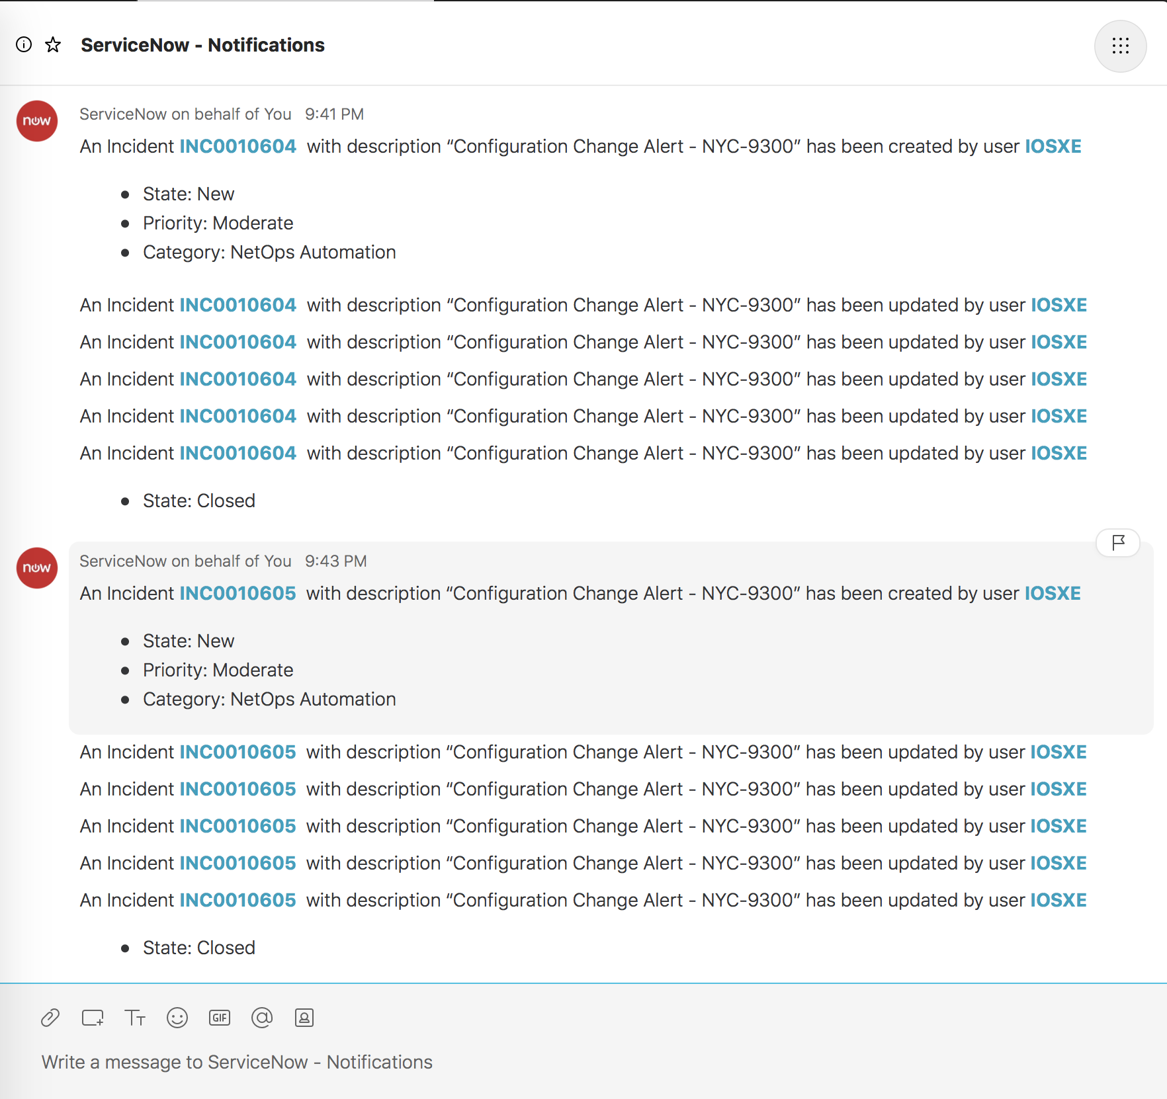
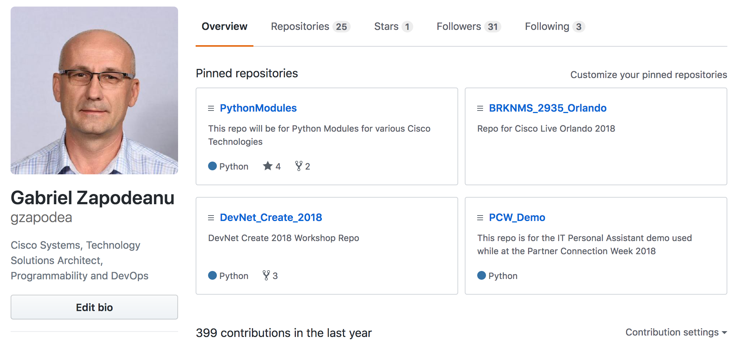
PubNub
ServiceNow
DNA Center
Update
Incident
WhatsOp App
Create
Incident
Webex Teams
GitHub
Guest Shell
Open IOS XE, Guest Shell
Routers, Switches, Wireless
NX OS, IOS XR

Slide 4
DEMO

Slide 5
Workshop Requirements
DevNet account – you have this or use your CCO account
GitHub account – http://github.com
ServiceNow developer account (optional)
DevNet CSR1000V sandbox –reserved and pre-provisioned for you: https://developer.cisco.com/site/sandbox/ -
IOS XE Programmability NETCONF-RESTCONF-YANG

Slide 6
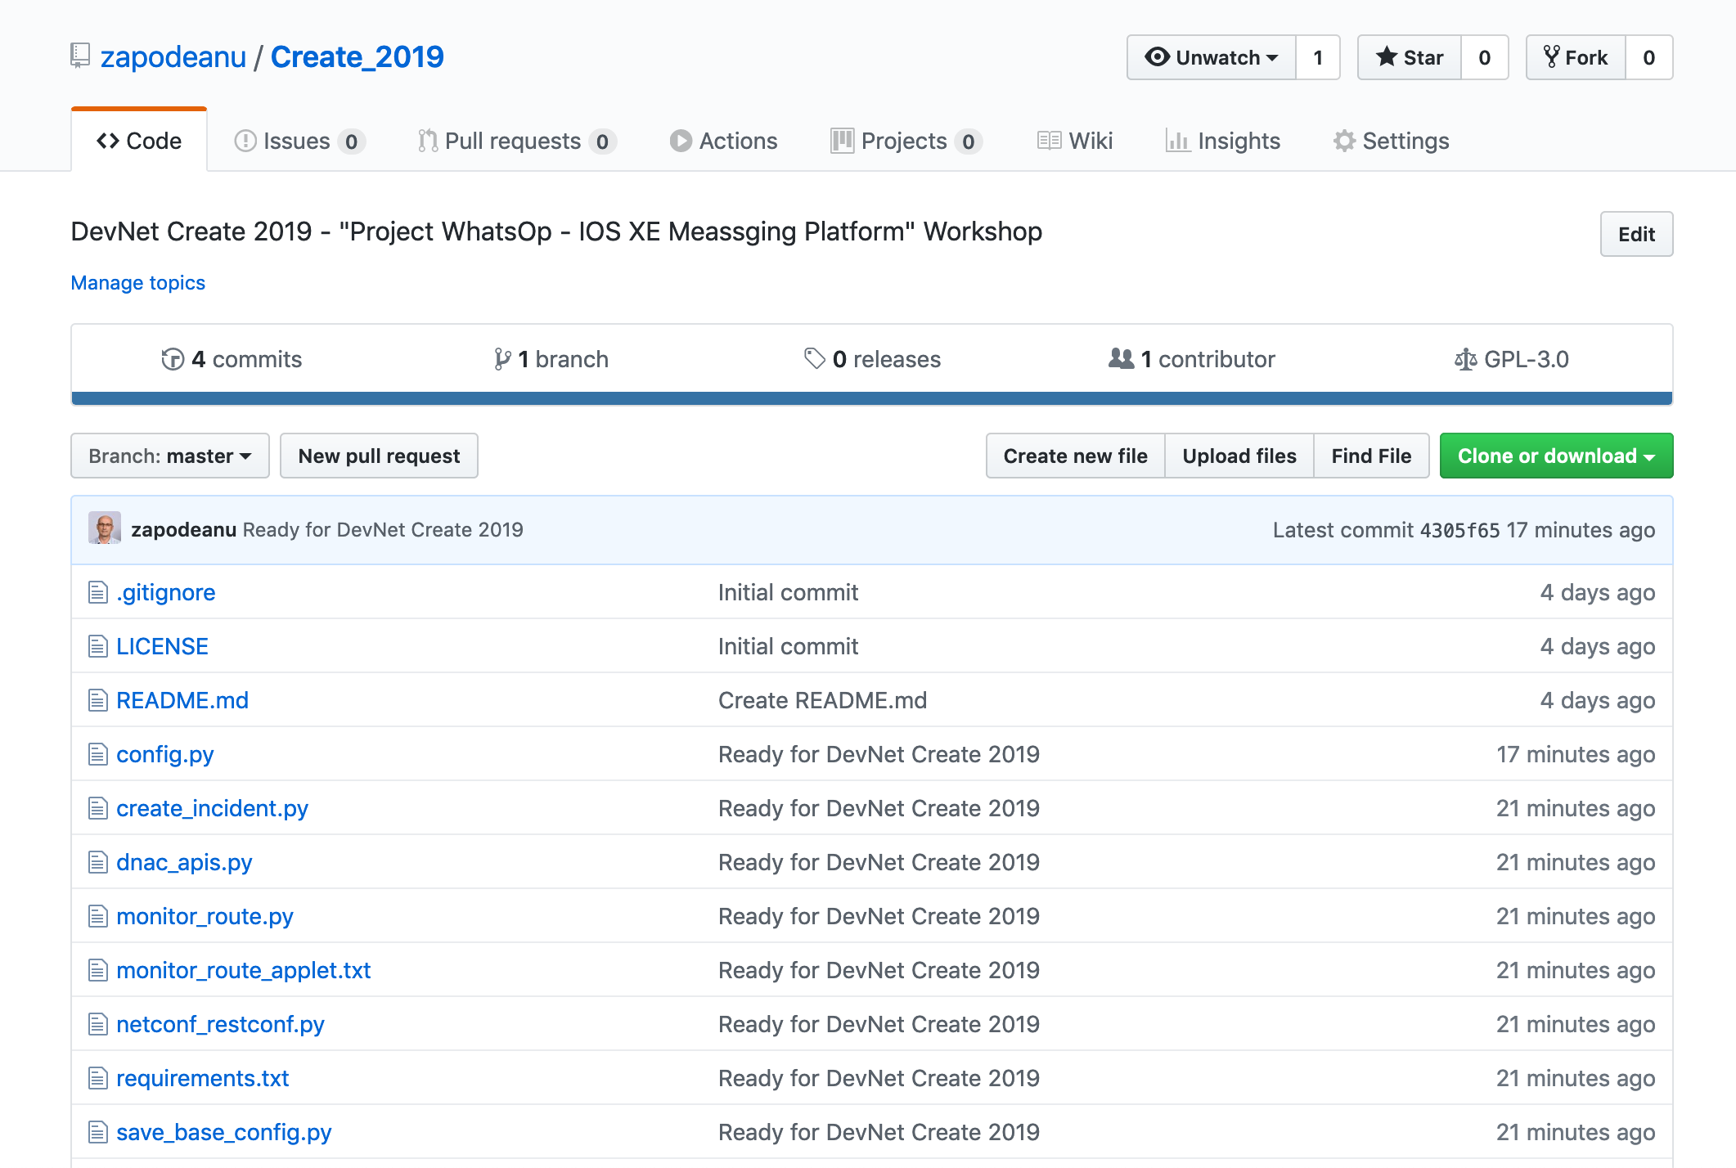
Session Presentation and Code
https://github.com/zapodeanu/Create_2019

Slide 7
Agenda
IOS XE Guest Shell
Device Management
Run Apps on Guest Shell
Embedded Event Manager
WhatsOp – IOS XE Messaging Platform

Slide 8
Agenda
IOS XE Guest Shell
Device Management
Run Apps on Guest Shell
Embedded Event Manager
WhatsOp – IOS XE Messaging Platform

Slide 9
Acronym Decoder / Technical Terms
GS - Guest Shell
IOx - Virtualization Manager
DNS - Domain Name System
sudo - Super User Do
PIP - Tool for installing and managing Python packages (Pip Installs Packages)
YUM - (Yellowdog Updater Modified) open source package management tool
CentOS - Linux distribution derived from RHEL
Bash - Bourne Again Shell, Linux standard shell
PNP - Plug and Play
CAF - Cisco Application Hosting Framework
ZTP - Zero Touch Provisioning

Slide 10



Guest Shell Application
Linux Shell Environment on your device
Integrated with IOS XE
On-box rapid prototyping
Device-level API Integration
Scripting (Python)
Linux Commands
Integrates into your Linux workflow
Linux applications
Guest Shell
Open Application Container
API
Network OS

Slide 11
IOS XE Guest Shell Overview
Guest Shell is a decoupled and secure environment running within a Linux Container (LXC)
From within the Guest Shell the network admin has the following capabilities:
Access to the network over Linux network interfaces
Access to /bootflash
Device management using CLI, NETCONF and RESTCONF
The ability to install and run Linux applications
The ability to install and run on-box Python Scripts

Slide 12
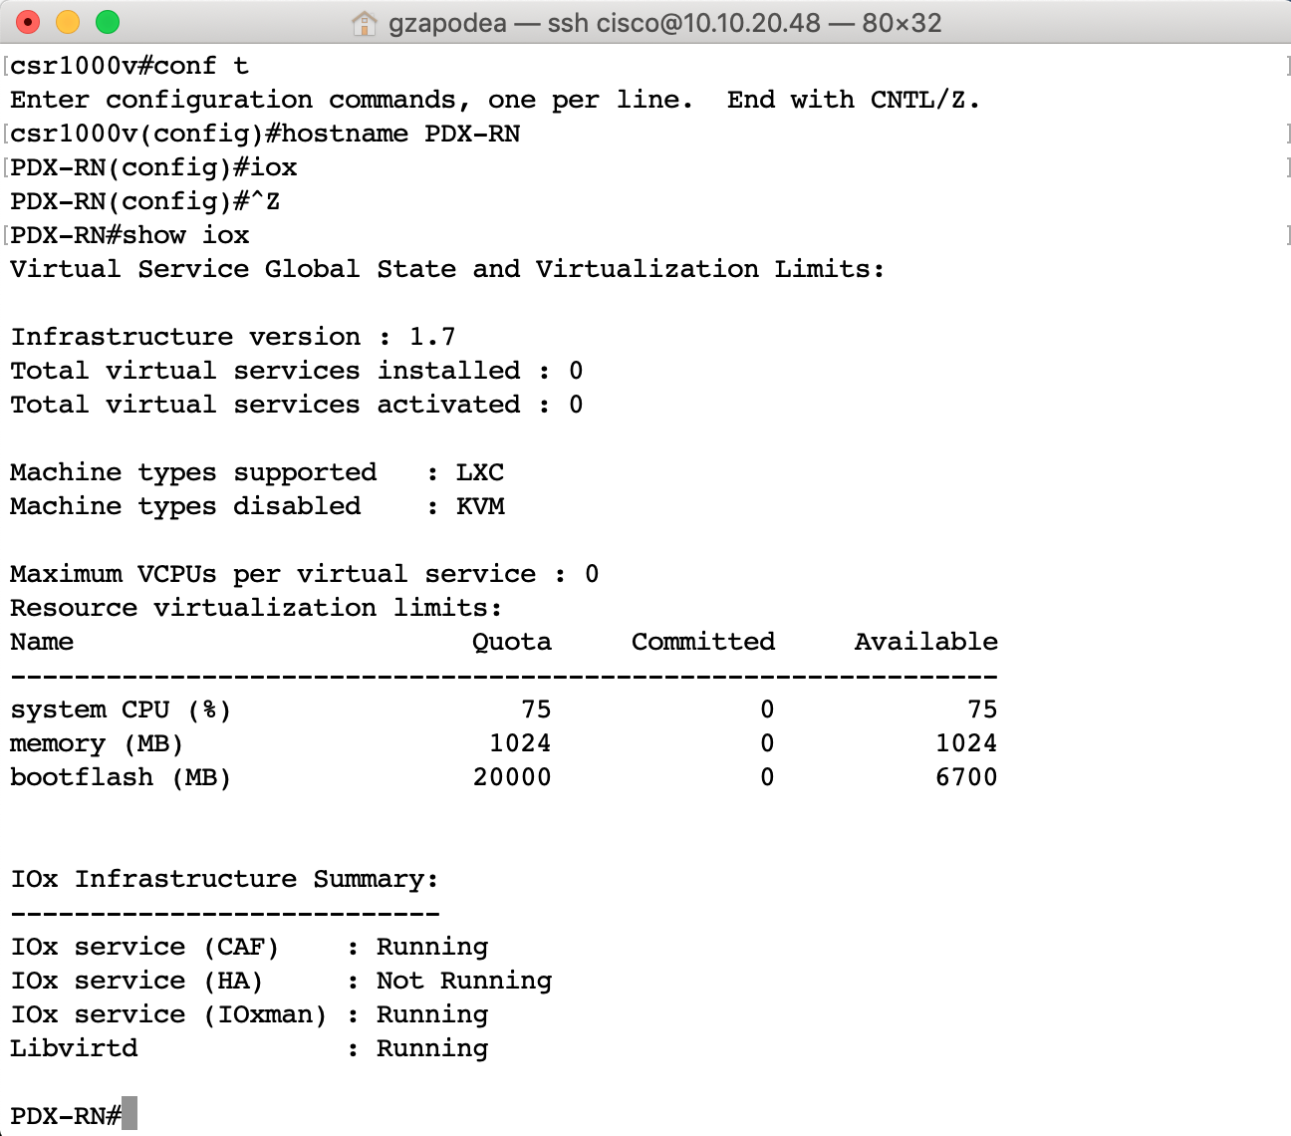
Configure IOx – Application Hosting Framework
IOx is the manager that handles guest shell and others apps
Use the provided instructions to connect to your sandbox
ssh to your CSR1000V router (10.10.20.48)
Change the name of your device
Enter the command iox in config mode
It will take a couple of minutes for the IOx services to start running
Verify IOx operations with the command show iox

Slide 13
Guest Shell Networking
Guest Shell network access using:
Management interface/ management vrf – Switches, Routers
VirtualPortGroup (VPG) for platforms without a management port
We are going to use the VPG mode to set up Guest Shell networking
The guest shell container will use the VPG to communicate with the IOS XE CSR and the Internet
NAT
LAN
Internet
GigabitEthernet1
10.10.20.48
VirtualPortGroup0
10.1.1.1
eth0
10.1.1.2
IOS XE
Guest Shell
Container
CSR 1000v
Notes:
Which Ip will be used to access the CSR from Guest Shell

Slide 14
Guest Shell Networking - continued
Interface GigabitEthernet 1 is connected to the Internet for external access
Need a VirtualPortGroup interface with static ip address
NAT set up between VPG and the GigabitEthernet 1
Configure your CSR1000V with these commands:
aaa new-model
aaa authentication login default local
aaa authorization exec default local
ip name-server 208.67.222.222
interface VirtualPortGroup0
ip address 10.1.1.1 255.255.255.0
description used_for_GS_access
ip nat inside
interface GigabitEthernet1
ip nat outside
ip access-list standard GS_NAT_ACL
permit 10.1.1.0 0.0.0.255
ip nat inside source list GS_NAT_ACL interface GigabitEthernet1 overload

Slide 15
Guest Shell Configuration
PDX-RN(config)#app-hosting appid guestshell
PDX-RN(config-app-hosting)#vnic gateway1 virtualportgroup 0 guest-interface 0 guest-ipaddress 10.1.1.2 netmask 255.255.255.0 gateway 10.1.1.1 name-server 208.67.222.222
PDX-RN#guestshell enable
Interface will be selected if configured in app-hosting
Please wait for completion
Guestshell enabled successfully
PDX-RN#show app-hosting list
App id State
------------------------------------------------------
guestshell RUNNING
PDX-RN#guestshell run sudo ping 10.1.1.1
PING 10.1.1.1 (10.1.1.1) 56(84) bytes of data.
64 bytes from 10.1.1.1: icmp_seq=1 ttl=255 time=0.527 ms
^C
PDX-RN#guestshell ?
destroy Disable and uninstall the guest shell service package
disable Disable the guest shell service package
enable Enable the guest shell service
run Execute/run program in the guest shell
PDX-RN#show app-hosting detail
Enable Guest Shell and verify connectivity from IOS XE:
This step is completed for you
Notes:
app-hosting appid guestshell
app-vnic management guest-interface 0
guest-ipaddress 10.93.130.44 netmask 255.255.255.0
name-server0 208.67.222.222
name-server1 208.67.220.220

Slide 16
Guest Shell Configuration - continued
Verify connectivity from Guest Shell to IOS XE and Internet
Update OS
PDX-RN#guestshell run bash
[guestshell@guestshell ~]$ cat /etc/resolv.conf
nameserver 208.67.222.222
[guestshell@guestshell ~]$ ping 10.1.1.1
PING 10.1.1.1 (10.1.1.1) 56(84) bytes of data.64 bytes from 10.1.1.1:
icmp_seq=1 ttl=255 time=0.568 ms64 bytes from 10.1.1.1:
icmp_seq=2 ttl=255 time=0.407 ms64 bytes from 10.1.1.1:
icmp_seq=3 ttl=255 time=0.467 ms64 bytes from 10.1.1.1:
^C
[guestshell@guestshell ~]$ sudo yum install bind-utils -y
[guestshell@guestshell ~]$ nslookup www.cisco.com
[guestshell@guestshell ~]$ sudo yum update -y

Slide 17
Guest Shell Troubleshooting
If not successful verify:
VirtualPortGroup and NAT Configuration
Guest Shell Configuration
Add a DNS configuration to the /etc/resolv.conf
PDX-RN#show run interface VirtualPortGroup 0
interface VirtualPortGroup0
ip address 10.1.1.1 255.255.255.0
ip nat inside
PDX-RN#show ip nat statistics
Total active translations: 0 (0 static, 0 dynamic; 0 extended)
Outside interfaces:
GigabitEthernet1
Inside interfaces:
VirtualPortGroup0
Hits: 14768 Misses: 86
PDX-RN#guestshell run sudo ifconfig
eth0: flags=4163<UP,BROADCAST,RUNNING,MULTICAST>. mtu 1500
inet 10.1.1.2 netmask 255.255.255.0 broadcast 10.1.1.255
inet6 fe80::5054:ddff:fed0:1dbf prefixlen 64
ether 52:54:dd:d0:1d:bf txqueuelen 1000 (Ethernet)
RX packets 10012 bytes 12216093 (11.6 MiB)
RX errors 0 dropped 0 overruns 0 frame 0
TX packets 5593 bytes 383829 (374.8 KiB)
TX errors 0 dropped 0 overruns 0 carrier 0 collisions 0
PDX-RN#guestshell run cat /etc/resolv.conf
nameserver 208.67.222.222

Slide 18
Install Python Packages
PDX-RN#guestshell run bash
[guestshell@guestshell ~]$ sudo pip install --upgrade pip
[guestshell@guestshell ~]$ sudo pip install requests
[guestshell@guestshell ~]$ sudo pip install requests[security]
[guestshell@guestshell ~]$ sudo pip install ncclient==0.6.3
[guestshell@guestshell ~]$ sudo pip install pubnub
[guestshell@guestshell ~]$ pip list
DEPRECATION: The default format will switch to columns in the future. You can use --format=(legacy|columns) (or define a format=(legacy|columns) in your pip.conf under the [list] section) to disable this warning.
…
cryptography (2.2.2)
pip (9.0.3)
requests (2.18.4)
…
[guestshell@guestshell ~]$ exit
Notes:
PIP List is abbreviated

Slide 19
Install Git and Nano on Guest Shell
Install Git on CentOs (GS): sudo yum install git -y
If the command completes without errors, you had git downloaded and installed.
To double-check that it is working correctly, try running Git's built-in version check
git version - git version 1.8.3.1
Set-up Git with your info:
git config --global user.name "Your GitHub Username "
git config --global user.email "you@example.com"
git config --global credential.helper "cache --timeout 3600"
Verify Git Config - git config --list
Additional packages:
sudo yum install curl-devel
sudo yum update -y nss curl libcurl
(May be required for git clone/pull operations on some platforms/software versions)
Reference: https://www.digitalocean.com/community/tutorials/how-to-install-git-on-centos-7
Install Nano: sudo yum install nano -y

Slide 20
Use Git to Transfer Files
PDX-RN#guestshell run bash
[guestshell@guestshell ~]$ cd /bootflash
[guestshell@guestshell bootflash]$ git clone 'https://github.com/zapodeanu/Create_2019.git'
Cloning into ‘Create_2019'...
Username for 'https://github.com': gzapodea
Password for 'https://gzapodea@github.com':
remote: Enumerating objects: 13, done.
remote: Counting objects: 100% (13/13), done.
remote: Compressing objects: 100% (12/12), done.
remote: Total 13 (delta 1), reused 8 (delta 0), pack-reused 0
Unpacking objects: 100% (13/13), done.
[guestshell@guestshell bootflash]$ ls /bootflash/Create_2019
LICENSE monitor_route.py service_now_apis.py
README.md monitor_route_applet.txt subscriber_listener.py
application_run.log netconf_restconf.py utils.py
config.py netconf_restconf.pyc config.pyc requirements.txt vasi_config.txt dnac_apis.py save_base_config.py
[guestshell@guestshell bootflash]$ exit
Clone the Code Repo

Slide 21
Guest Shell – Other Resources
File operations IOS XE:
mkdir flash:/path/to/folder
delete /force /recursive flash:/path/to/folder
dir flash:
more flash:/path/to/file (display content of file)
File operations Guest Shell (sometimes sudo is required)
mkdir /bootflash/path/to/folder
rm -rf /bootflash/path/to/folder
ls /bootflash/
cat /bootflash/path/to/file (display the content of file)
Verify the IOS XE Programmability Guide for additional configurations (for example proxy configurations) and troubleshooting options

Slide 22
Agenda
IOS XE Guest Shell
Device Management
Python CLI
NETCONF
RESTCONF
Run Apps on Guest Shell
Embedded Event Manager
WhatsOp – IOS XE Messaging Platform

Slide 23
Python CLI Module
Allows the user’s Python scripts to run IOS CLI commands on the host device
Interactive Python Prompt
guestshell run python
Python Script
guestshell run python /bootflash/path/to/file.py

Slide 24
Device Management from Guest Shell Using the Interactive Python Prompt
PDX-RN#guestshell run python
Python 2.7.5 (default, Jun 17 2014, 18:11:42)
[GCC 4.8.2 20140120 (Red Hat 4.8.2-16)] on linux2
Type "help", "copyright", "credits" or "license" for more information.
>>> import cli
>>> from cli import execute
>>> output = execute("show run | in hostname")
>>> print output
hostname PDX-RN
>>> print(execute("show interface Gi1"))
GigabitEthernet1 is up, line protocol is up
Hardware is CSR vNIC, address is 0050.56ac.232f (bia 0050.56ac.232f)
Description: DON'T TOUCH ME
Internet address is 10.10.20.48/24
MTU 1500 bytes, BW 1000000 Kbit/sec, DLY 10 usec,
reliability 255/255, txload 1/255, rxload 1/255 Encapsulation ARPA, loopback not set
…
>>> exit()
Notes:
Look at the first few lines of code, and the last one. I can write a small python code to collect the info I want.

Slide 25
NETCONF and RESTCONF
Options to program network devices:
NETCONF - Network Configuration Protocol
RESTCONF - REST-like access to the YANG Data Model
gRPC - open-source universal RPC framework, started by Google
NETCONF
RESTCONF
gRPC
YANG Data Models
Open
Native
Configuration and Operation
Device Features
SNMP
Interface
BGP
QoS
ACL
…
Notes:
This is a reference to understand there is much more that NETCONF, RESTCONF and gRPC.
gRPC and NETCONF support notifications
GRPC / GNMI - designed for generic client/server communication, By default gRPC uses protocol buffers, Google’s mature open source mechanism for serializing structured data (although it can be used with other data formats such as JSON)
In gRPC a client application can directly call methods on a server application on a different machine as if it was a local object, making it easier for you to create distributed applications and services. As in many RPC systems, gRPC is based around the idea of defining a service, specifying the methods that can be called remotely with their parameters and return types. On the server side, the server implements this interface and runs a gRPC server to handle client calls. On the client side, the client has a stub (referred to as just a client in some languages) that provides the same methods as the server.

Slide 26
Protocol Summary
Standardisation | RFC 6241 | RFC 8040 | Open Initiative
Encoding | XML | XML / JSON | JSON / GPB
Session-layer Service (RPC) Support | ✓ | ✓ | ✓
Connection Oriented | ✓ | ✗ | ✓
Session Security | SSH / SOAP | HTTPS | HTTPS
NETCONF
RESTCONF
gRPC
Notes:
How Many prefer NETCONF/XML vs RESTCONF/JSON?
RESTconf: GET, PUT, POST, DELETE
NETCONF: GET, EDIT, COPY, DELETE
GRPC / GNMI - designed for generic client/server communication
In gRPC a client application can directly call methods on a server application on a different machine as if it was a local object, making it easier for you to create distributed applications and services. As in many RPC systems, gRPC is based around the idea of defining a service, specifying the methods that can be called remotely with their parameters and return types. On the server side, the server implements this interface and runs a gRPC server to handle client calls. On the client side, the client has a stub (referred to as just a client in some languages) that provides the same methods as the server.
By default gRPC uses protocol buffers, Google’s mature open source mechanism for serializing structured data (although it can be used with other data formats such as JSON)

Slide 27


NETCONF and/or RESTCONF ?
<rpc-reply message-id="urn:uuid:50bf9d6e-7e5c-4182-ae6b-972a055ceef7" xmlns="urn:ietf:params:xml:ns:netconf:base:1.0" xmlns:nc="urn:ietf:params:xml:ns:netconf:base:1.0">
<data>
<interfaces-state xmlns="urn:ietf:params:xml:ns:yang:ietf-interfaces">
<interface>
<name>GigabitEthernet1</name>
<admin-status>up</admin-status>
<oper-status>up</oper-status>
<phys-address>00:0c:29:6c:81:06</phys-address>
<speed>1024000000</speed>
<statistics>
<in-octets>5432293472</in-octets>
<in-unicast-pkts>28518075</in-unicast-pkts>
……………
<out-octets>2901845514</out-octets>
<out-unicast-pkts>18850398</out-unicast-pkts>
</statistics>
</interface>
</interfaces-state>
</data></rpc-reply>
{
"ietf-interfaces:interface": {
"name": "GigabitEthernet1",
"admin-status": "up",
"oper-status": "up",
"last-change": "2018-01-17T21:49:17.000387+00:00",
"phys-address": "00:0c:29:6c:81:06",
"speed": 1024000000,
"statistics": {
"in-octets": 5425386232,
"in-unicast-pkts": 28489134,
……………
"out-octets": 2899535736,
"out-unicast-pkts": 18844784
}
}
}
YANG Data Models
Notes:
Both protocols provide to us the same operational data

Slide 28
Python CLI or RESTCONF ?
PDX-RN#guestshell run python
>>> print(cli("show interface Gi1"))
GigabitEthernet1 is up, line protocol is up
Hardware is CSR vNIC, address is 0050.56ac.22c3 (bia 0050.56ac.22c3)
Description: DON'T TOUCH ME
Internet address is 10.10.20.48/24
Full Duplex, 1000Mbps, link type is auto, media type RJ45
Last clearing of "show interface" counters never
5 minute input rate 100000 bits/sec, 3 packets/sec
5 minute output rate 1000 bits/sec, 2 packets/sec
40897 packets input, 49324086 bytes, 0 no buffer
Received 0 broadcasts (0 IP multicasts)
21486 packets output, 1658940 bytes, 0 underruns
>>>
Unstructured Data
RESTCONF:
{
"speed" : 1024000000 ,
"statistics" : {
"out-octets" : 1744814 ,
"out-unicast-pkts" : 21961 ,
"in-unicast-pkts" : 40599 ,
"out-broadcast-pkts" : 0 ,
"in-octets" : 47467395 } ,
"name" : "GigabitEthernet1" ,
"oper-status" : "up" ,
"phys-address" : "00:50:56:ac:23:2f" ,
"type" : "iana-if-type:ethernetCsmacd" ,
"last-change" : "2018-04-07T23:53:44.000208+00:00" ,
"admin-status" : "up" ,
"if-index" : 0
}
Structured Data
There is a need to know both

Slide 29
Agenda
IOS XE Guest Shell
Device Management
Run Apps on Guest Shell
Embedded Event Manager
WhatsOp – IOS XE Messaging Platform

Slide 30
Edit and Save config.py
[guestshell@guestshell Create_2019]$ nano config.py
# This file contains the:
# …
# PubNub Keys
# Network device username/password
# Update this section with your PubNub keys
PUB_KEY = 'pub-c-27ec1abf-2226-4140-884f-2ca9…..'
SUB_KEY = 'sub-c-32e23d48-d884-11e8-b7c4-3e16c…..'
SEC_KEY = 'sec-c-xyz'
CHANNEL = ‘ to be provided’
…
# Update this section with the Service Now instance to be used for labs
SNOW_URL = 'https://dev48476.service-now.com/api/now'
SNOW_ADMIN = 'IOSXE'
SNOW_DEV = 'IOSXE'
SNOW_PASS = ‘to be provided’
^G Get Help ^O WriteOut ^R Read File ^Y Prev Page ^K Cut Text ^C Cur Pos
^X Exit ^J Justify ^W Where Is ^V Next Page ^U UnCut Text^T To Spell
Please do not change keys

Slide 31
Prepare to Execute Python Apps
PDX-RN#wri mem
PDX-RN#guestshell run bash
[guestshell@guestshell ~]$ cd /bootflash/
[guestshell@guestshell bootflash]$ cd Create_2019
Get from GitHub the latest application code:
[guestshell@guestshell Create_2019]$ git pull
Already up-to-date.
Read and execute the initialize script:
[guestshell@guestshell Create_2019]$ python save_base_config.py
Created additional vty lines
Configured VASI interfaces, vrf R, Loopback111, and routing
Configured EEM applet
End of save_base_config.py Application Run
[guestshell@guestshell Create_2019_p]$
Download the latest code
Save baseline configuration
save_base_config.py

Slide 32
Python Scripts on Guest Shell
Create a new test ServiceNow incident
PDX-RN#guestshell run bash
[guestshell@guestshell ~]$ cd /bootflash/Create_2019/
[guestshell@guestshell Create_2019]$ python create_incident.py
APIUSER ServiceNow sysid is: d0e8467d4f1913…
ServiceNow REST API call response: 201
('Created ServiceNow Incident with the number: ', 'INC0010941')
End Application Run
Read and Run the file
create_incident.py

Slide 33
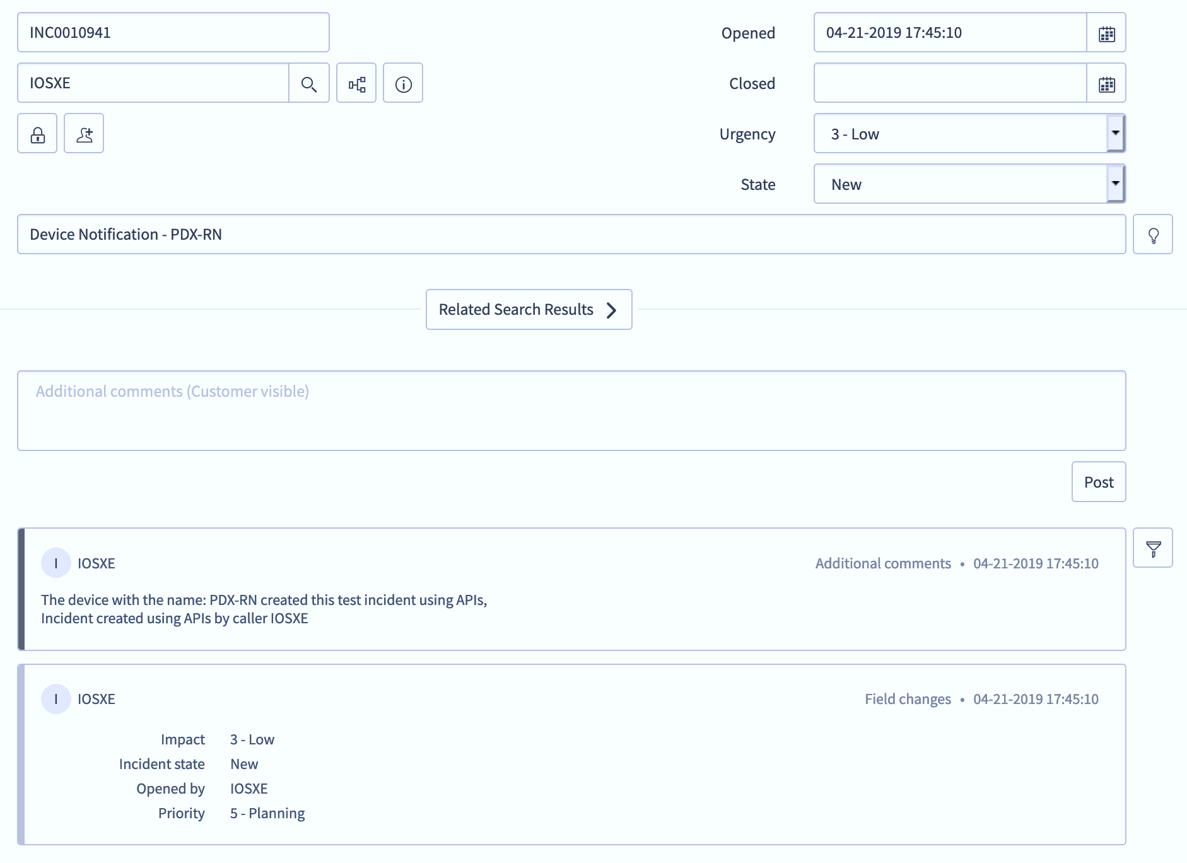
ServiceNow Incident

Slide 34
Agenda
IOS XE Guest Shell
Device Management
Run Apps on Guest Shell
Embedded Event Manager
WhatsOp – IOS XE Messaging Platform

Slide 35
EEM Python Policies
Offers the ability to monitor events and take action when the monitored events occur or when a threshold is reached
Embedded Event Manager (EEM) uses software programs known as event detectors to determine when an EEM event occurs
Embedded Event Manager (EEM) policies support Python scripts
Configured EEM policies run within the Guest Shell

Slide 36
EEM Configuration
EEM monitor_route applet
PDX-RN#sh run | b event
event manager applet monitor_route
event routing network 11.1.0.0/16 type remove ge 16 le 16 vrf default maxrun 30
action 1.0 cli command "enable"
action 2.0 cli command "guestshell run python /bootflash/Create_2019/monitor_route.py 11.1.0.0/16"
action 3.0 cli command "exit"
action 4.0 cli command "end"
!
maximum run for script
default is 20 seconds
event detector
Execute script: /path/script_name.py + arguments

Slide 37
Agenda
IOS XE Guest Shell
Device Management
Run Apps on Guest Shell
Embedded Event Manager
WhatsOp – IOS XE Messaging Platform

Slide 38
Project WhatsOp - IOS XE Messaging Platform
The Challenge
Slow time to respond to outages
Cost for creating, updating, troubleshooting and closing tickets
The Goal
Automated detection of issues and tickets operations
Troubleshoot and configure the customer network directly from ServiceNow
The Solution
Integration between Cisco IOS XE, Guest Shell, DNA Center, ServiceNow, PubNub, and Webex Teams
The Results
Lower Mean Time to Repair
Lower cost of providing service to customer

Slide 39
PubNub
ServiceNow
DNA Center
Update
Incident
WhatsOp App
Create
Incident
Webex Teams
GitHub
Guest Shell
Open IOS XE, Guest Shell
Routers, Switches, Wireless
NX OS, IOS XR

Slide 40
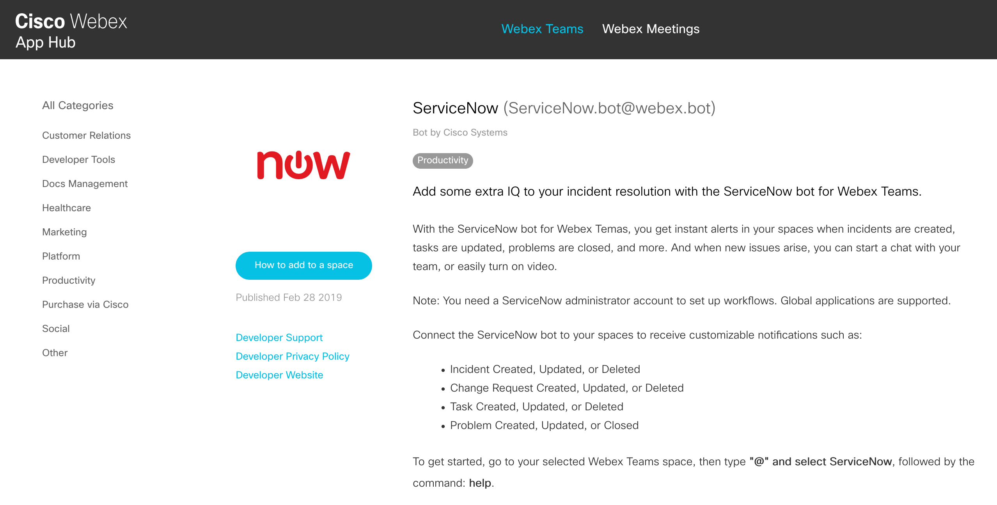
ServiceNow to Webex Teams
https://apphub.webex.com/categories/all/bots/servicenow-3117

Slide 41
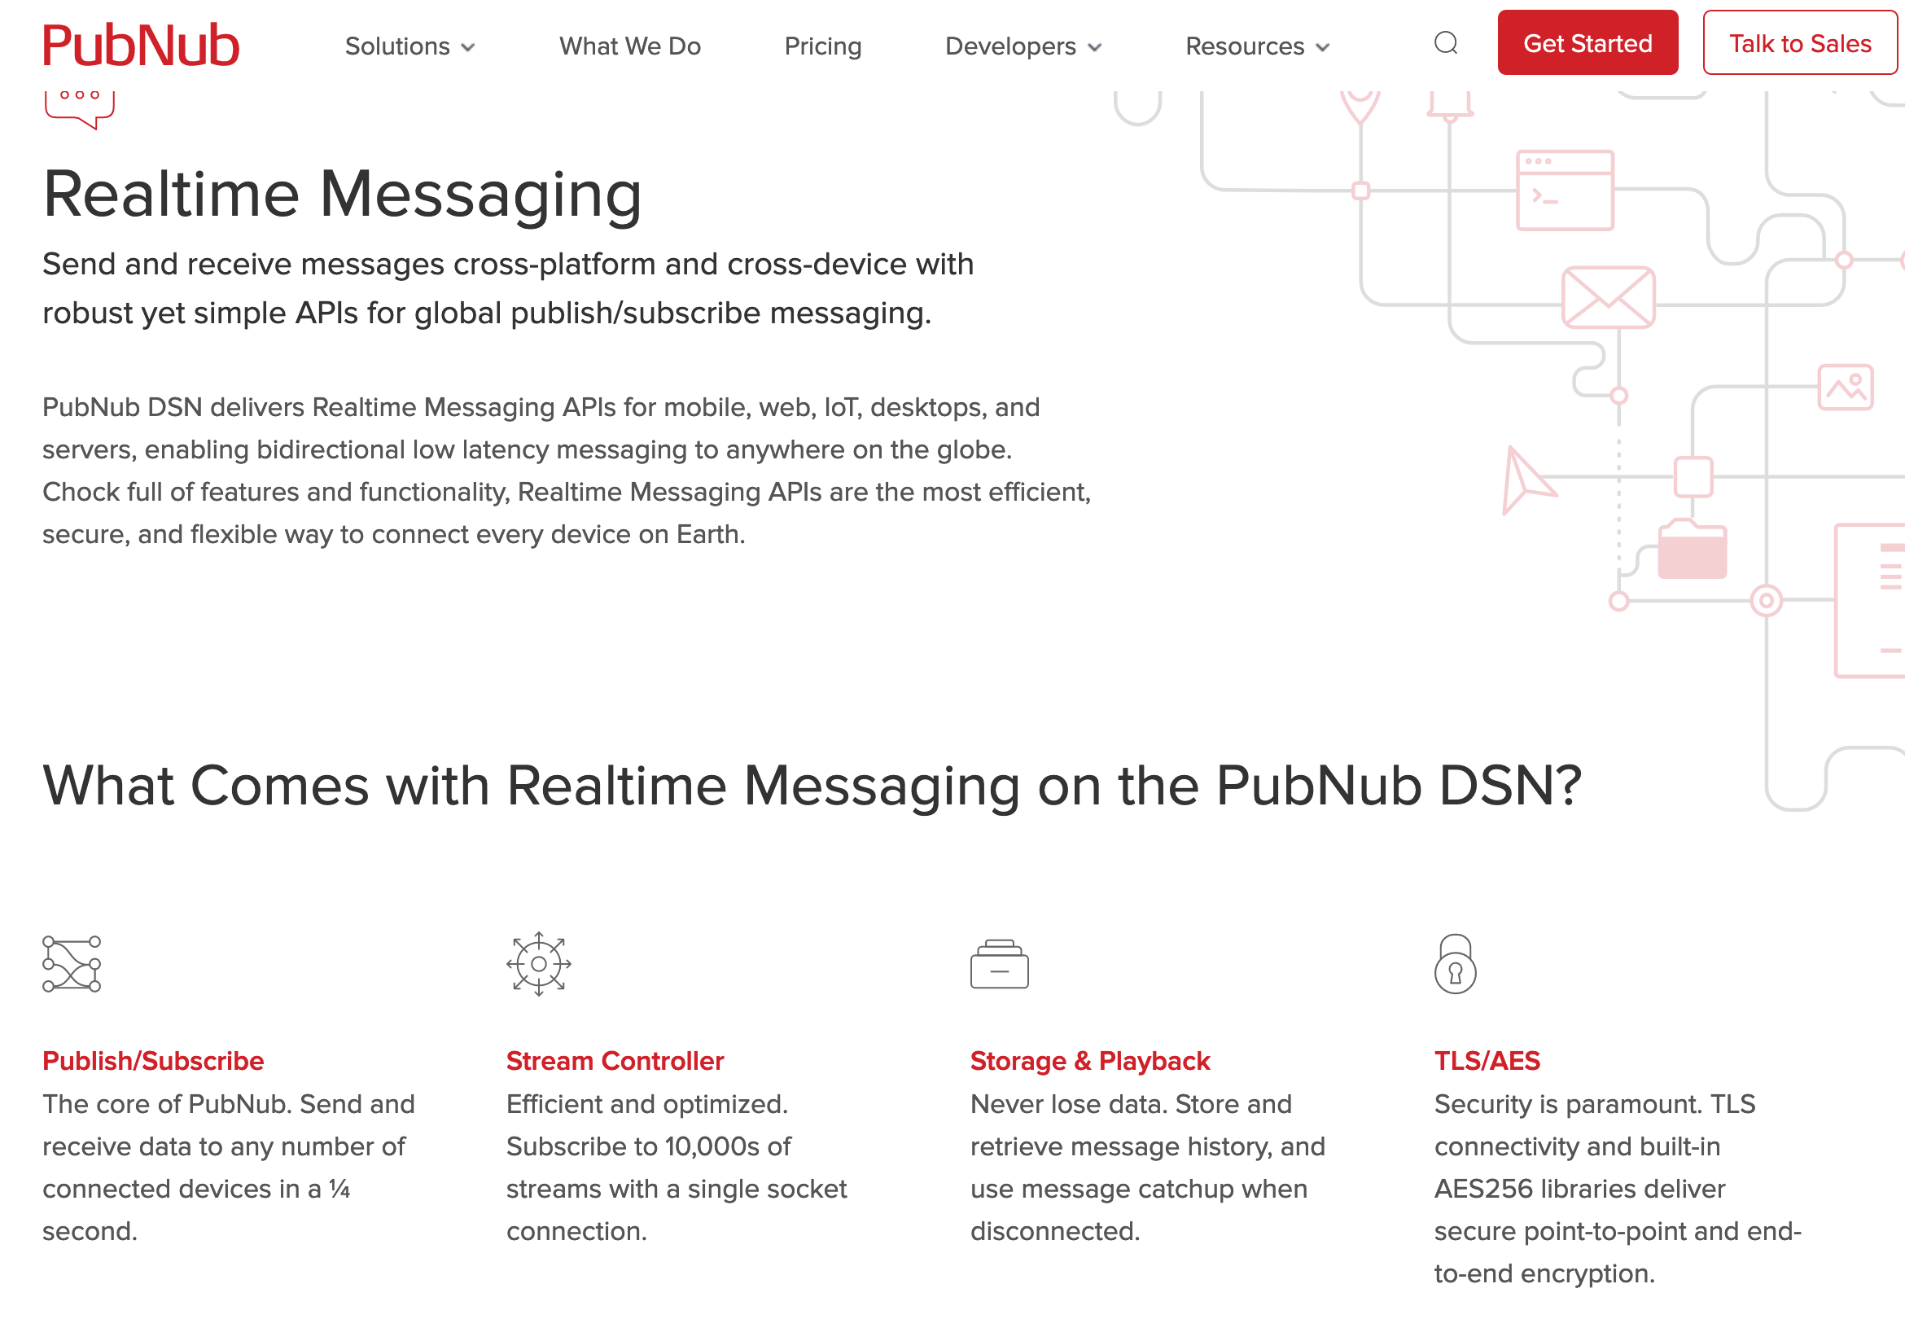
PubNub
Real time messaging platform
250ms latency worldwide.
Device establishes secure tunnel to PubNub, encryption
Presence
Great SDKs
Try it free

Slide 42
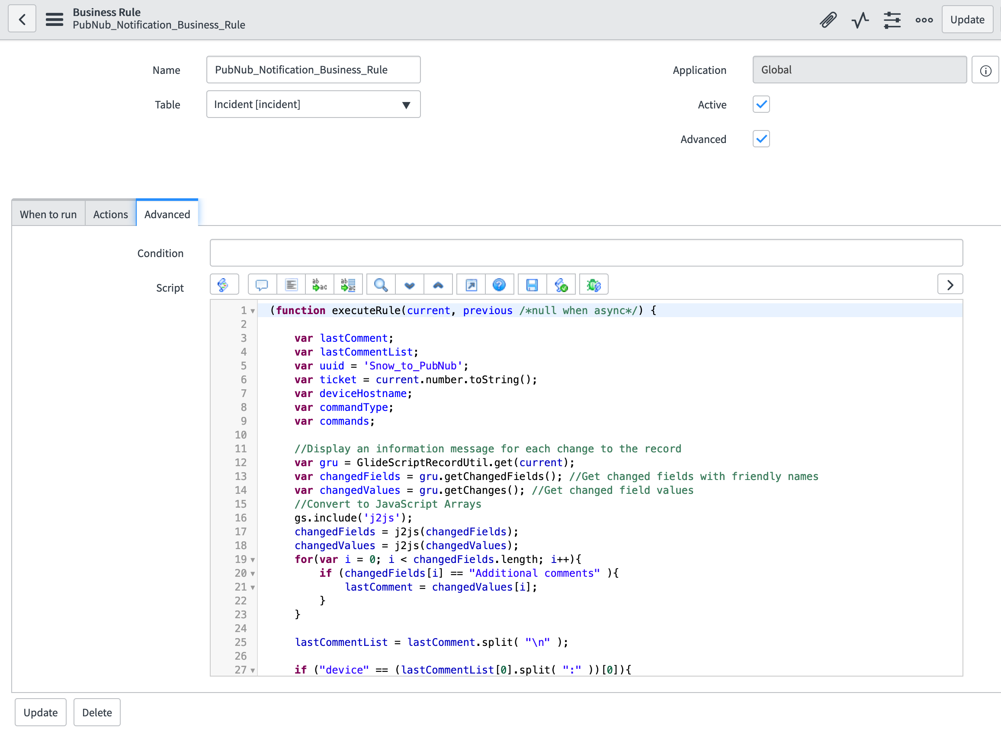
ServiceNow to PubNub
Define a business rule to execute when new or updated incidents
Will publish message to ServiceNow
Messages structure defined by my application
Credits: Integration written by:
Pete Johnson and Vallard Bernicosa

Slide 43
Start Guest Shell Listener
[guestshell@guestshell ~]$ cd /bootflash/Create_2019/
[guestshell@guestshell Create_2019]$ python subscriber_listener.py
The device hostname: PDX-RN
Subscriber connected successfully
New message received:
{
"source_uuid" : "Snow_to_PubNub" ,
"device" : "PDX-RN" ,
"incident" : "INC0010941" ,
"commands" : "show ip eigrp neigh" ,
"command_type" : "exec"
}
Exec command received: show ip eigrp neigh
EIGRP-IPv4 Neighbors for AS(11)
H Address Interface Hold Uptime SRTT RTO Q Seq
(sec) (ms) Cnt Num
0 11.11.11.2 vl11 14 1w4d 1 100 0 2
Command result: Successful

Slide 44
ServiceNow Message Structure
device: PDX-RN
config_type: exec
commands: show ip eigrp neigh
New message received:
{
"source_uuid" : "Snow_to_PubNub" ,
"device" : "PDX-RN" ,
"incident" : "INC0010941" ,
"commands" : "show ip eigrp neigh" ,
"command_type" : "exec"
}
Exec command received: show ip eigrp neigh
device: PDX-9300
config_type: config
commands: interface Loopback111 ! no shut

Slide 45
Cisco
TAC
Pub/Sub
Messaging
Platform
ITSM
DNA Center
Create
Update
Incident
WhatsOp App
Any Notifications
Webex Teams
IM/Chat
Alexa
Enterprise
SVC
Guest Shell
Open IOS XE, Guest Shell
Routers, Switches, Wireless
NX OS, IOS XR

Slide 46
Thank you

